Slide 1
AI
Almost Intuitive (but not quite)

Slide 2
How much there is to know?

Slide 3
How much do i have to know?

Slide 4
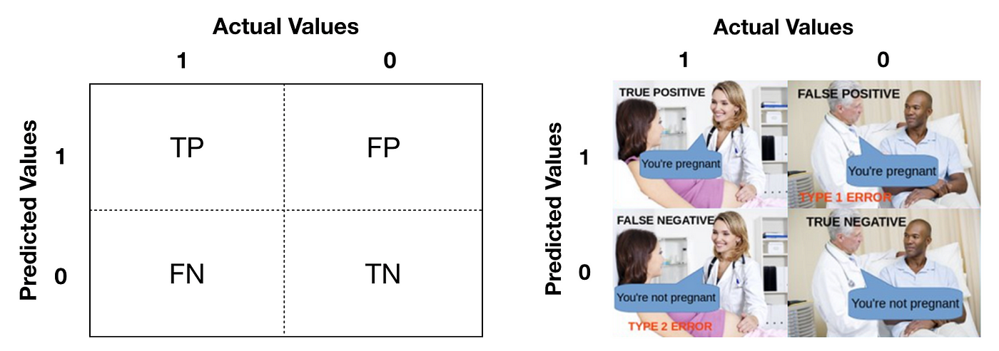

Slide 5
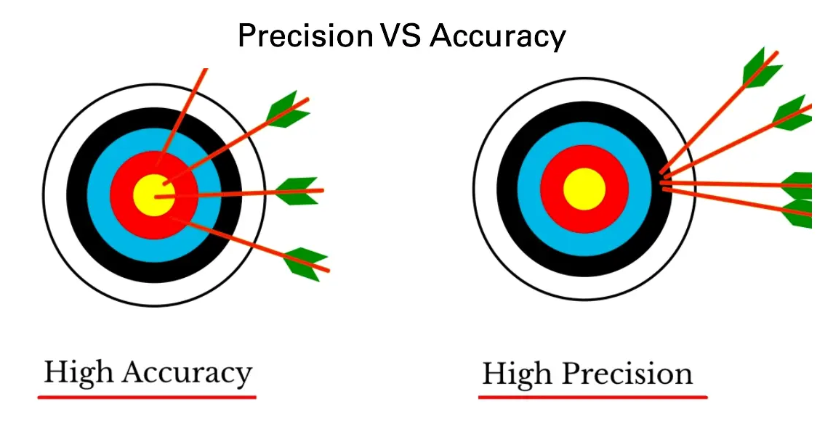

Slide 6
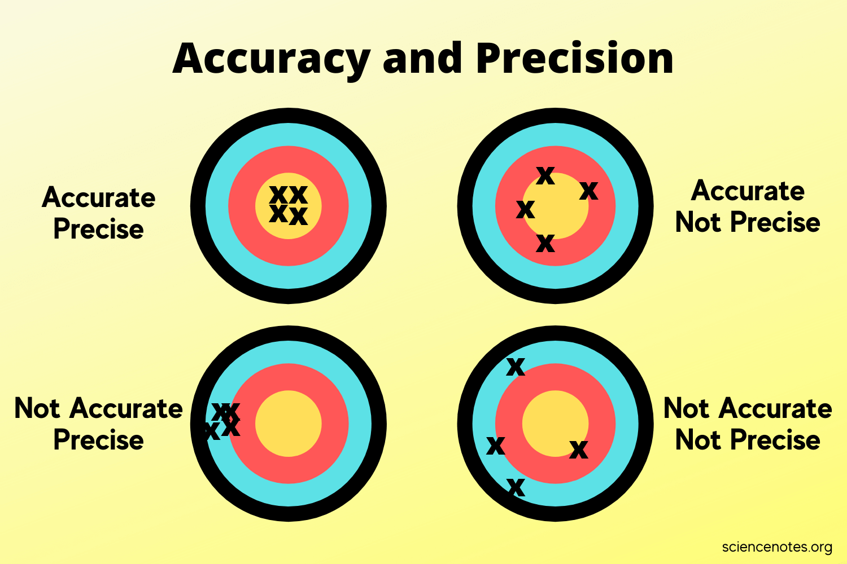

Slide 7
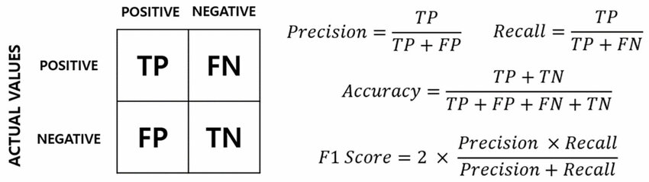

Slide 8
What is machine learning?
A subset of AI where systems learn from data instead of being explicitly programmed.
Includes supervised learning, unsupervised learning, and reinforcement learning.
Examples: Spam filters, recommendation systems (Netflix, YouTube).
Machine learning can also be defined as the process of solving a practical problem by:
Gathering a dataset
Algorithmically building a statistical model based on that dataset.
That statistical model is assumed to be used somehow to solve the practical problem.

Slide 9
What is supervised learning?
Imagine you are learning how to tell apples 🍏 from oranges 🍊.
Your teacher gives you a big box of fruits with labels:
"This is an apple." ✅
"This is an orange." ✅
You look at the fruits and start noticing patterns:
Apples are usually round and green/red 🍏.
Oranges are bumpy and orange 🍊.

Slide 10
What is supervised learning?
The teacher gives you a new fruit but doesn’t tell you what it is.
You look at it and think, “It’s round and red… it must be an apple!”
Your teacher checks your answer:
If you’re right, great! ✅
If you’re wrong, the teacher corrects you, and you learn from the mistake. ❌

Slide 11
How to?
import numpy as np
import pandas as pd
from sklearn.model_selection import train_test_split
from sklearn.neighbors import KNeighborsClassifier
from sklearn.metrics import accuracy_score
# Create a simple apples and oranges dataset
data = {
'Weight': [150, 160, 170, 180, 140, 130, 120, 190, 200, 210],
'Texture': [1, 1, 1, 1, 0, 0, 0, 1, 1, 1], # 1 = Smooth (Apple), 0 = Bumpy (Orange)
'Label': [0, 0, 0, 0, 1, 1, 1, 0, 0, 0] # 0 = Apple, 1 = Orange
}

Slide 12
How to?
# Convert to DataFrame
df = pd.DataFrame(data)
X = df[['Weight', 'Texture']]
y = df['Label']
# Split into training and testing sets (80% train, 20% test)
X_train, X_test, y_train, y_test = train_test_split(X, y, test_size=0.2, random_state=42)
# Create a K-Nearest Neighbors (KNN) classifier
model = KNeighborsClassifier(n_neighbors=3)
# Train the model (Supervised Learning: learns from labeled data)
model.fit(X_train, y_train)

Slide 13
How to?
# Make predictions
predictions = model.predict(X_test)
# Check accuracy
accuracy = accuracy_score(y_test, predictions)
print(f'Model Accuracy: {accuracy * 100:.2f}%')
# Show some predictions
predicted_df = pd.DataFrame({'Actual': y_test, 'Predicted': predictions})
print(predicted_df.head())

Slide 14
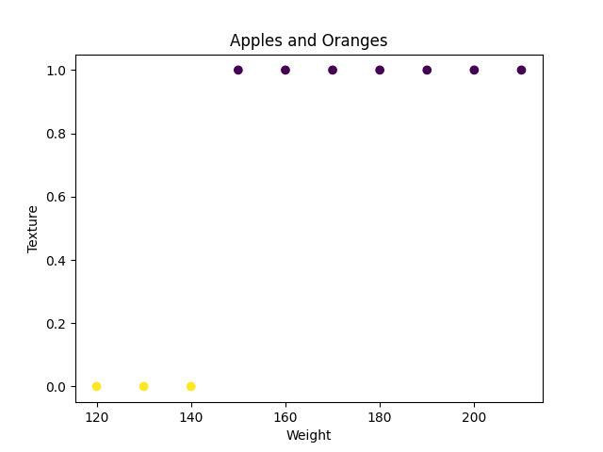
Model Accuracy: 100.0%

Slide 15
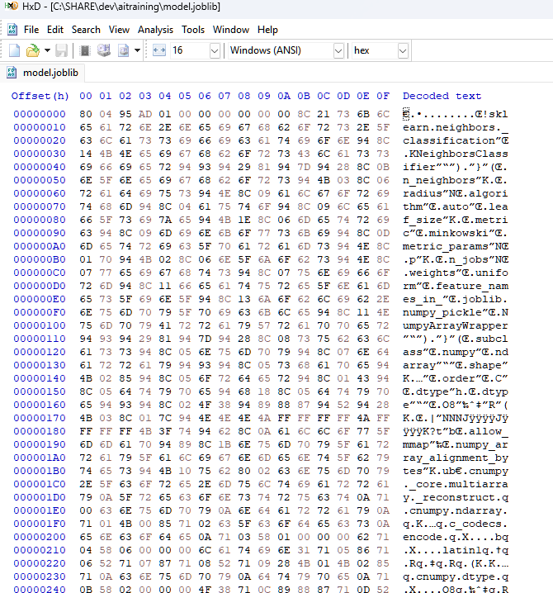
How does the model look like?

Slide 16
What is UNsupervised learning?
Same fruits. Different city…
There are tons of fruits everywhere, but there are no labels—nobody tells you what’s what.
So, what do you do?
You start grouping similar toys together based on what they look like:
All the apples go in one pile.
All the oranges go in another pile.
All the bananas go in another pile.

Slide 17
What is UNsupervised learning?
You don’t know the names of the fruits, but you figured out patterns and sorted them yourself!
No teacher, no labels, no right or wrong answers.
The AI finds patterns in data and groups similar things together.

Slide 18
What is reinforcement learning?
Imagine you're training a puppy!
You have a new puppy, and you want to teach it a trick—rolling over.
But the puppy doesn’t know what to do yet!
So, every time the puppy does something close to rolling over, you:
✅ Give it a treat! 🍖 (Reward)
❌ If it does something wrong, no treat. (No reward)
Over time, the puppy figures out that rolling over = yummy treats!
It keeps trying different moves until it learns the best way to get the most treats.

Slide 19
How to?
from sklearn.metrics import accuracy_score
import joblib
import pandas as pd
from sklearn.cluster import KMeans
import matplotlib.pyplot as plt
# Create a simple apples, oranges, and bananas dataset
data = {
'Weight': [150, 160, 170, 180, 140, 130, 120, 190, 200, 210, 110, 115, 105],
'Texture': [1, 1, 1, 1, 0, 0, 0, 1, 1, 1, 2, 2, 2]
# 1 = Smooth (Apple), 0 = Bumpy (Orange), 2 = Soft (Banana)
}
# Convert to DataFrame
df = pd.DataFrame(data)
X = df[['Weight', 'Texture']]

Slide 20
How to?
# Apply K-Means clustering (Unsupervised Learning: No labels)
kmeans = KMeans(n_clusters=3, random_state=42)
df['Cluster'] = kmeans.fit_predict(X)
# Print clustered data
print(df)
# Plot the clusters
plt.scatter(df['Weight'], df['Texture'], c=df['Cluster'], cmap='viridis')
plt.xlabel('Weight')
plt.ylabel('Texture')
plt.title('K-Means Clustering of Apples, Oranges, and Bananas')
plt.show()
#print accuracy
accuracy = accuracy_score(df['Texture'], df['Cluster'])
print(f'Model Accuracy: {accuracy * 100:.2f}%')
# Save the model
joblib.dump(kmeans, 'unsupervised_apples_oranges_bananas_kmeans.joblib')

Slide 21
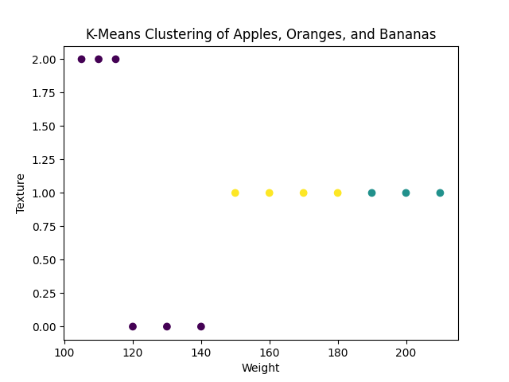
Model Accuracy: 46.5%

Slide 22
What is Deep Learning?
Let’s say we want to teach a robot to recognize a fruit in another galaxy.
We take thousands of images of apples, oranges, and bananas. Each image has a label:
✅ Apple
✅ Orange
✅ Banana
The machine looks at all these images and starts to learn patterns—just like how a child learns to recognize different fruits over time!

Slide 23
What is Deep Learning?
Instead of just looking at the whole picture at once, this time Deep Learning breaks it down into layers—each layer learns something different:
First Layer (Input Layer): Takes in raw fruit images (color, shape, texture).
Hidden Layers (Middle Layers): Breaks down the images into patterns (edges, curves, colors).
Final Layer (Output Layer): Decides if the fruit is an apple, orange, or banana.
Each layer passes information to the next, getting smarter at identifying fruits!

Slide 24
What is Deep Learning?
The machine doesn’t get everything right at first! It makes mistakes, but we correct it by telling it the right answer.
📢 AI: "This is an apple!"
👩‍🏫 You: "Nope, that's a banana!"
The AI adjusts itself and learns from mistakes. After many training sessions, it becomes super smart and can recognize fruits with high accuracy!
(Unless it doesn’t)

Slide 25
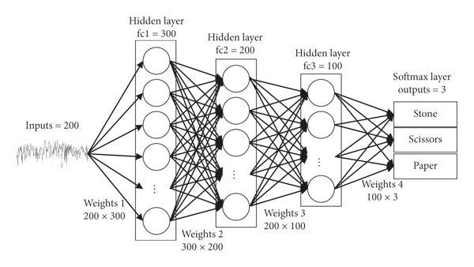

Slide 26
How to?
import numpy as np
import pandas as pd
import matplotlib.pyplot as plt
import tensorflow as tf
from tensorflow import keras
from sklearn.model_selection import train_test_split
from sklearn.preprocessing import LabelEncoder
# Create a dataset for apples, oranges, and bananas
data = {
'Weight': [150, 160, 170, 180, 140, 130, 120, 190, 200, 210, 110, 115, 105],
'Texture': [1, 1, 1, 1, 0, 0, 0, 1, 1, 1, 2, 2, 2], # 1 = Smooth, 0 = Bumpy, 2 = Soft
'Fruit': ['Apple', 'Apple', 'Apple', 'Apple', 'Orange', 'Orange', 'Orange', 'Apple', 'Apple', 'Apple', 'Banana', 'Banana', 'Banana']
}
# Convert to DataFrame
df = pd.DataFrame(data)
X = df[['Weight', 'Texture']]
y = df['Fruit']

Slide 27
How to?
# Encode labels (Apple=0, Orange=1, Banana=2)
label_encoder = LabelEncoder()
y_encoded = label_encoder.fit_transform(y)
# Split data into training and testing sets
X_train, X_test, y_train, y_test = train_test_split(X, y_encoded, test_size=0.2, random_state=42)
# Build a simple deep learning model
model = keras.Sequential([
keras.layers.Dense(8, input_shape=(2,), activation='relu'),
keras.layers.Dense(8, activation='relu'),
keras.layers.Dense(3, activation='softmax') # 3 output classes
])
# Compile the model
model.compile(optimizer='adam', loss='sparse_categorical_crossentropy', metrics=['accuracy'])
# Train the model
model.fit(X_train, y_train, epochs=100, verbose=0)

Slide 28
How to?
# Evaluate the model
loss, accuracy = model.evaluate(X_test, y_test, verbose=0)
print(f'Model Accuracy: {accuracy * 100:.2f}%')
# Make predictions
predictions = model.predict(X_test)
predicted_classes = np.argmax(predictions, axis=1)
# Convert predictions back to fruit names
predicted_fruits = label_encoder.inverse_transform(predicted_classes)
actual_fruits = label_encoder.inverse_transform(y_test)
# Show some predictions
results_df = pd.DataFrame({'Actual': actual_fruits, 'Predicted': predicted_fruits})
print(results_df.head())

Slide 29
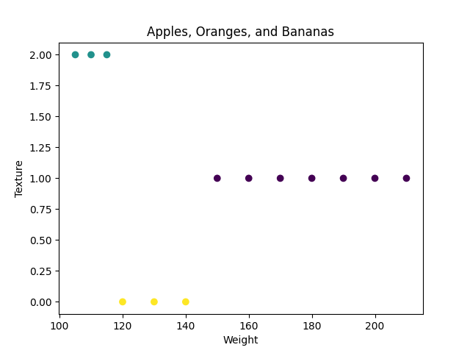
Model Accuracy: 66.67% (100 epochs)
Model Accuracy: 33.33% (8 epochs)

Slide 30
LLMs
A Large Language Model (LLM) is a type of AI model that is trained to understand and generate human-like text.
It uses deep learning techniques to process and predict language patterns, making it capable of answering questions, writing essays, generating code, and even having conversations.
The LLM is fed huge amounts of text (books, articles, etc.).
It analyzes billions of words and learns patterns in language.
Instead of memorizing facts, it predicts the next word based on context.

Slide 31
LLMs
When learning to identify apples and oranges, a model's parameters might represent:
Weight (heavier = apple, lighter = orange)
Color (red/green = apple, orange = orange)
Over time, the AI adjusts these parameters to improve accuracy!
Weight (W) → "How much does the color matter?"
Bias (B) → "Should I adjust my decision if the fruit is lighter than expected?"
Mathematically, a simple neuron works like this:
Output=(Weight×Input)+Bias

Slide 32
LLMs: Learning
When an AI model starts training, its parameters are random (so it makes bad predictions).
During training, the model adjusts parameters step by step to reduce errors.
This process is called Gradient Descent – a method that tweaks parameters to make the model smarter.
The goal: Minimize mistakes and improve accuracy!
If the AI misclassifies an orange as an apple, it adjusts its weights and biases so that next time, it gets it right!
Output=(Weight×Input)+Bias

Slide 33
LLMs: Parameter hype
Set by humans before training. eg. Learning rate, Number of layers
They are fixed before training.
Baking a cake model:
Hyperparameters = The recipe (amount of flour, sugar, temperature).
Parameters = How the dough reacts while baking (adjusting flavors & texture).

Slide 34
LLMs: Aha moment
Too many parameters = Slow & expensive models
Badly trained parameters = AI makes mistakes
Parameters are like memory & decision-makers in an AI.
They adjust and learn over time to make predictions better and smarter!
But they chat…?

Slide 35
LLMs: How?
Reads your message
Processes the words and understands context (Tokenization)
Predicts the best next word based on past training data
Keeps generating words until the response is complete

Slide 36
LLMs: Transformers?
Tokenization: Breaks text into small pieces (tokens)
Encoding: Converts tokens into numbers for processing
Attention Mechanism : Focuses on important words in the sentence
Word Prediction: Predicts the best next word to generate a response
Decoding: Converts the response back into human language

Slide 37
LLMs: Tokenization
When you type a message, the LLM doesn’t see raw words—instead, it converts your text into tokens (small units like words or subwords).
"How are you?" becomes: [How] [are] [you] [?]
The model assigns numbers (vectors) to tokens so they can be processed mathematically.
It analyzes relationships between words using a Transformer model

Slide 38
LLMs: Tokenization: Splitting
["The", "quick", "brown", "fox", "jumps", "over", "the", "lazy", "dog", "."]
Each token gets converted into a unique number (ID):
[101, 2023, 4248, 4415, 8555, 2058, 1996, 13971, 3899, 1012]
Punctuation marks (, . ? !) are treated as separate tokens:
"Hello, world!" → ["Hello", ",", "world", "!"]

Slide 39
LLMs: Tokenization: Subword Tokenization
Instead of splitting only by words, AI models like GPT and BERT break down unfamiliar words into smaller pieces.
💡 Example: If the model doesn’t recognize "laziness", it might split it into:
👉 ["lazy", "ness"]
👉 ["un", "happiness"]
Some models may go even further:
👉 ["un", "hap", "pi", "ness"]

Slide 40
LLMs: Tokenization
Special tokens are added:
[CLS] → Start of a sentence (for BERT).
[SEP] → Separates multiple sentences.
GPT-3 can handle up to 2048 tokens, while GPT-4 has a much larger limit (up to 32,000+ tokens in some versions).
Different tokenizers for different models!
gpt2, google-bert…

Slide 41
LLMs: Vectors
Words are also converted into vectors so AI can understand and compare them.
"King" → [0.8, 1.2, -0.5, 0.3]
"Queen" → [0.7, 1.3, -0.4, 0.2]
"Apple" → [1.5, -0.2, 0.9, 0.7]
The closer two vectors are, the more similar their meanings!
AI can learn relationships like:
"King" - "Man" + "Woman" ≈ "Queen"

Slide 42
LLMs: How?
import spacy
# Load English NLP model
nlp = spacy.load("en_core_web_md")
# Convert words into vectors
word1 = nlp("king").vector
word2 = nlp("queen").vector
# Compare similarity
similarity = nlp("king").similarity(nlp("queen"))
print(f"Similarity between 'king' and 'queen': {similarity:.2f}") # Closer to 1 means more similar

Slide 43
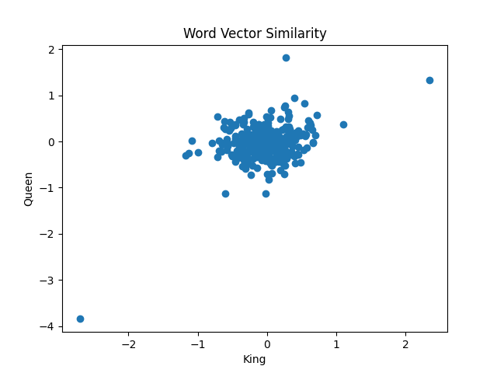
Vector for 'king': [-0.60644 -0.51205 0.0064921 -0.29194 -0.56515 ]...
Vector for 'queen': [-1.1209 -0.28809 0.12336 -0.21608 -0.09869]...
Similarity between 'king' and 'queen': 0.38

Slide 44
LLMs: Vectors
Since vectors are just lists of numbers, we can measure how similar two things are.
Cosine Similarity – Measures the angle between two vectors.
Euclidean Distance – Measures how far two vectors are apart.
If the vectors for "happy" and "joyful" are very close, the AI knows they are synonyms!
If the vectors for "dog" and "banana" are far apart, AI knows they are unrelated.
Cosine Similarity is between -1 and 1
Euclidean Distance is between 0 to infinity

Slide 45
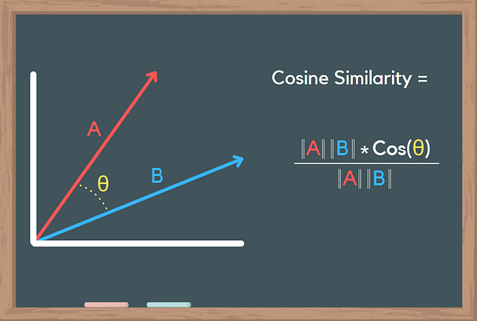
LLMs: Vectors: Cosine Similarity

Slide 46
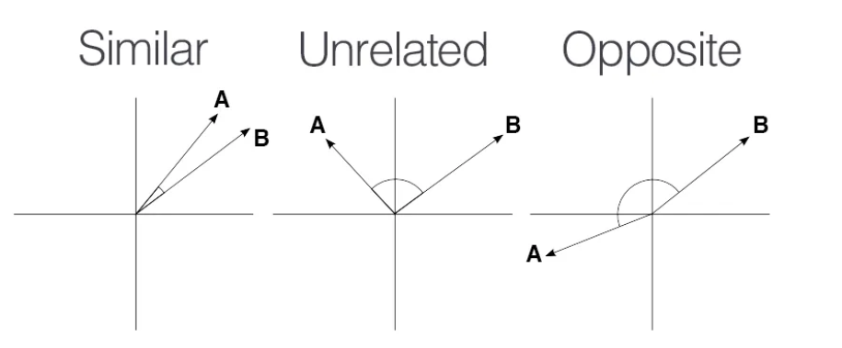
LLMs: Vectors: Cosine Similarity

Slide 47
LLMs: Cosine
from sklearn.feature_extraction.text import TfidfVectorizer
from sklearn.metrics.pairwise import cosine_similarity
# Sample text data
doc1 = "I love deep learning and AI"
doc2 = "Deep learning is amazing for AI"
# Convert text into vectors using TF-IDF
vectorizer = TfidfVectorizer()
tfidf_matrix = vectorizer.fit_transform([doc1, doc2])
# Calculate Cosine Similarity
similarity_score = cosine_similarity(tfidf_matrix[0:1], tfidf_matrix[1:2])

Slide 48
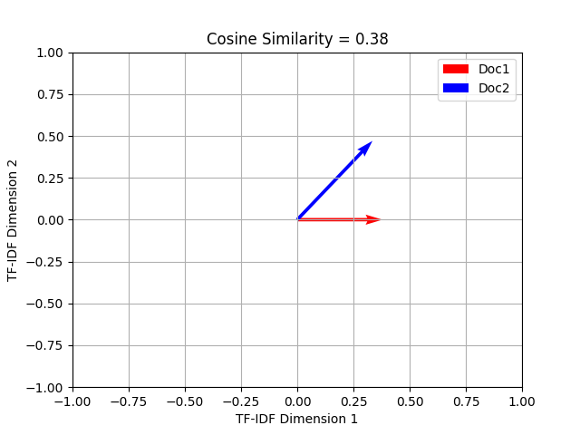

Slide 49
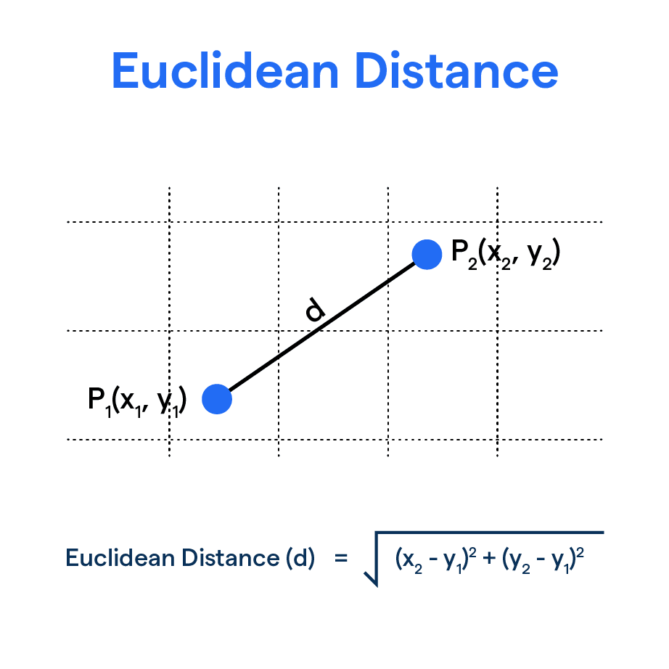

LLMs: Vectors: Euclidean Distance

Slide 50
RAG
Retrieval-Augmented Generation (RAG) is a type of AI model that combines search (retrieval) with text generation to provide more accurate and up-to-date responses.
Instead of only using pre-trained knowledge, it retrieves real-world data from external sources.
This allows it to stay accurate, handle niche topics, and reduce misinformation.
Fine-tuning is expensive!

Slide 51
Vector Store
A Vector Store (or Vector Database) is a specialized database designed to store, search, and retrieve vector embeddings efficiently.
Instead of storing text or numbers, it stores vectors (numerical representations of data).
Store Vectors (Data Ingestion):
Convert text, images, or audio into vector embeddings using AI models.
Store these vectors in a database along with metadata (e.g., document ID, timestamp).

Slide 52
Vector Store
Indexing (Building a Searchable Space):
Uses techniques like FAISS (Facebook AI Similarity Search) to organize vectors in a searchable way.
Allows for fast retrieval of similar vectors.
Search & Retrieve (Finding the Best Match):
When a new query comes in, it is converted into a vector.
The vector store compares it with stored vectors and finds the most similar ones using:
Cosine Similarity (Measures angle similarity)
Euclidean Distance (Measures absolute distance)
Dot Product (Measures projection similarity)

Slide 53
Dot Product
The dot product (also called the scalar product) is a mathematical operation that measures the similarity between two vectors.
Think of it as a way to check how much two vectors "point in the same direction."
A⋅B=A₁B₁+A₂B₂+...+A_{n}B_{n}
A=[2,3,4],B=[1,0,2] A⋅B=(2×1)+(3×0)+(4×2) =2+0+8=10

Slide 54
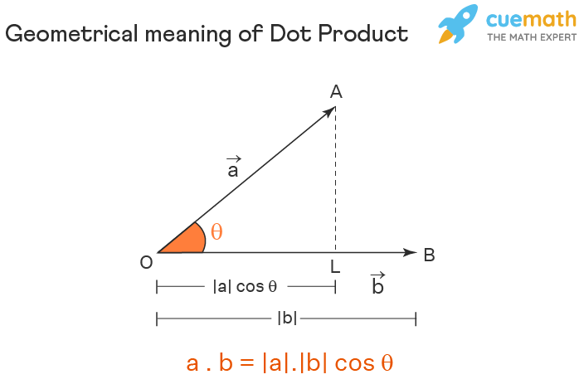

Slide 55
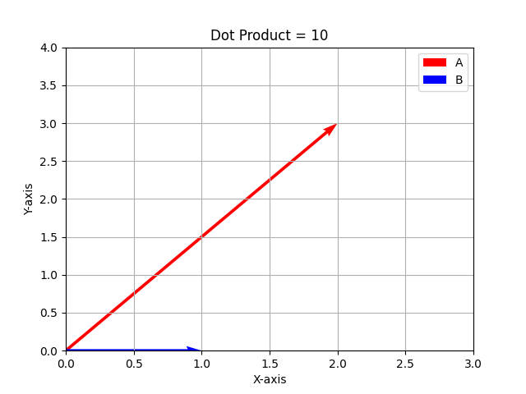
Dot Product: How?
import numpy as np
# Define two vectors
A = np.array([2, 3, 4])
B = np.array([1, 0, 2])
# Compute dot product
dot_product = np.dot(A, B)
print(f"Dot Product: {dot_product}")

Slide 56
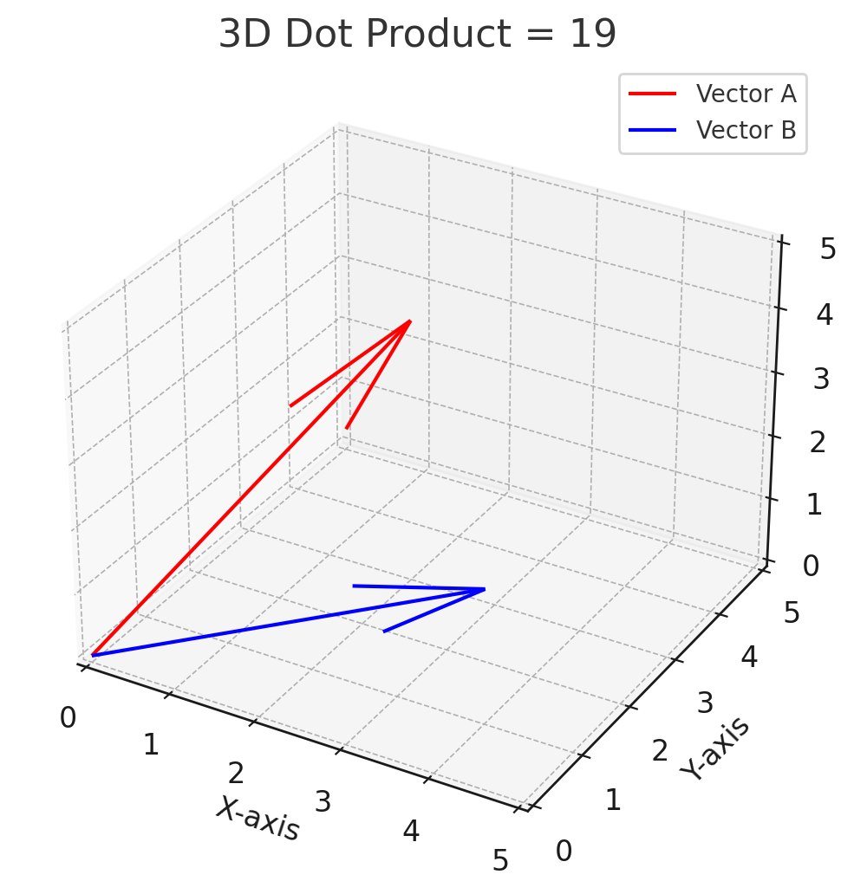
Dot Product: How?
Positive >0 Vectors point in the same direction Similar
Zero =0 Vectors are perpendicular (90° apart) No relation
Negative <0 Vectors point in opposite directions Dissimilar

Slide 57
Retrieve The Data
import numpy as np
import faiss
from sentence_transformers import SentenceTransformer
from transformers import pipeline
# Step 1: Sample knowledge base (documents)
docs = [ "GPT-4 has multimodal capabilities, meaning it can process text and images.",
"AI models are improving real-time translation, making it easier to communicate across languages.",
"Self-driving cars use deep learning for object detection and navigation.",
"Quantum computing has the potential to revolutionize AI by solving complex problems much faster.",
"Large language models like ChatGPT rely on transformer architectures to generate responses."]

Slide 58
Retrieve The Data
# Step 2: Convert documents into embeddings
model = SentenceTransformer("all-MiniLM-L6-v2")
doc_embeddings = model.encode(docs)
# Step 3: Create a FAISS index for fast retrieval
index = faiss.IndexFlatL2(doc_embeddings.shape[1])
index.add(np.array(doc_embeddings))
# Step 4: User query
query = "What are the latest advancements in AI?"
query_embedding = model.encode([query])

Slide 59
Retrieve The Data
# Step 5: Retrieve the most relevant document
D, I = index.search(np.array(query_embedding), k=1)
retrieved_doc = docs[I[0][0]]
# Step 6: Generate a response using a language model (simulated here)
gpt_pipeline = pipeline("text-generation", model="gpt2")
prompt = f"Based on the following information, answer the query:\n\n{retrieved_doc}\n\nQuery: {query}\nAnswer: "
response = gpt_pipeline(prompt, max_length=100, num_return_sequences=1)[0]['generated_text']
# Step 7: Print results
print("Retrieved Document:", retrieved_doc)
print("Generated Response:", response)
#Quantum computing has the potential to revolutionize AI by solving complex problems much faster.

Slide 60
Vector DB Dimensions
In a vector database, dimensions refer to the number of numerical values (features) in each vector. This determines the size of the vector space and how detailed or complex the embeddings are.
Think of dimensions as the number of characteristics that describe an object.
A 2D vector has two features (e.g., [X, Y] like a point on a graph).
A 3D vector has three features (e.g., [X, Y, Z] like spatial coordinates).
A 512D vector has 512 features (used in AI for text/image embeddings).

Slide 61
Vector DB Dimensions
More dimensions = more detailed embeddings (e.g., capturing word meanings, image patterns).
Higher-dimensional spaces allow for better similarity search but require more computing power.
Reducing dimensions can speed up search performance (via PCA, dimensionality reduction).

Slide 62
